Slide 1
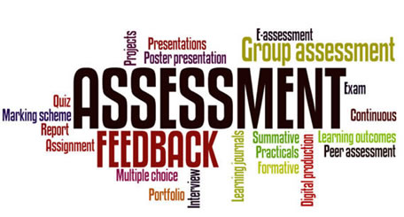

Slide 2
Basic concepts in Assessment and Evaluation
Test
Measurements
Assessment
Evaluation

Slide 3
Assessment
Process by which evidence of student achievement is obtained and evaluated. Information is obtained relative to objective it include testing, interpreting and placing information in context. It is the process of gathering and organizing data- the basis for decision making (evaluation).

Slide 5
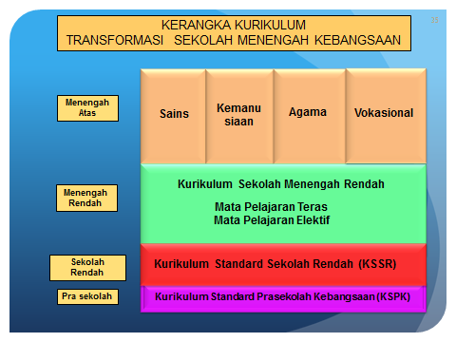

Slide 6
Penggabungan hasil pentaksiran berasaskan sekolah (pentaksiran sekolah) dengan pentaksiran dan peperiksaan berpusat .
Pengenalan secara meluas penggunaan ujian psikometrik dalam penggumpulan data dan maklumat tentang perkembangan dan pertumbuhan murid.
Peluasan pentaksiran untuk merangkumi bidang-bidang lain seperti penglibatan murid dalam pelbagai kegiatan kokurikulum, dan aspek-aspek lain berkaitan domain keinsanan dan sahsiah.
Pengupayaan sekolah dan guru dalam proses pentaksiran pendidikan pelajar-pelajar mereka sendiri.
Pengupayaan sekolah dan guru dalam proses pentaksiran pendidikan pelajar-pelajar mereka sendiri.

Slide 7
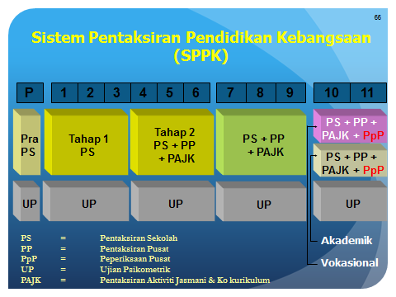

Slide 9
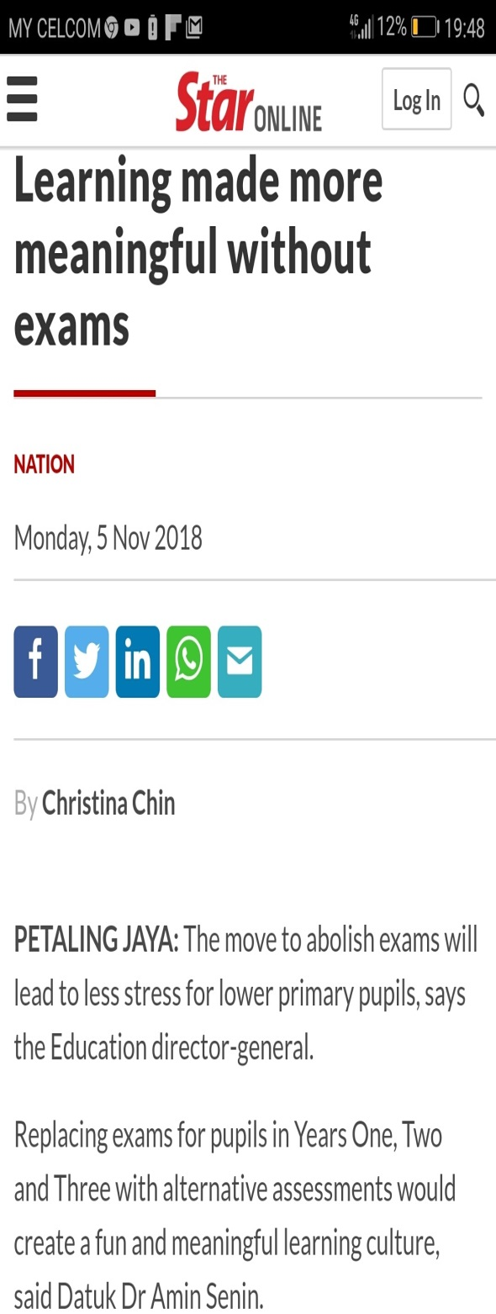
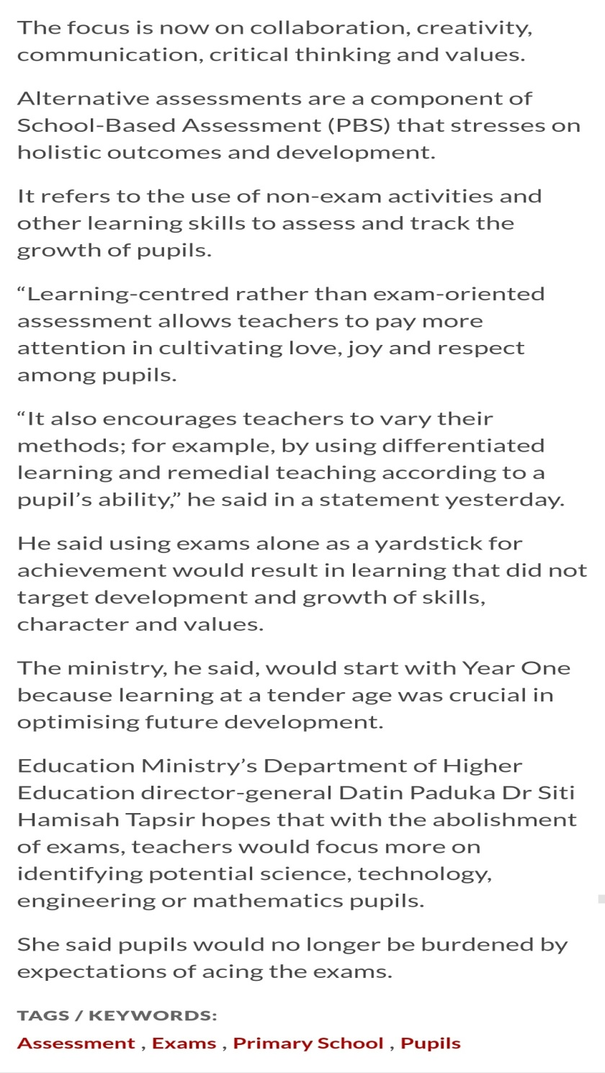

Slide 10
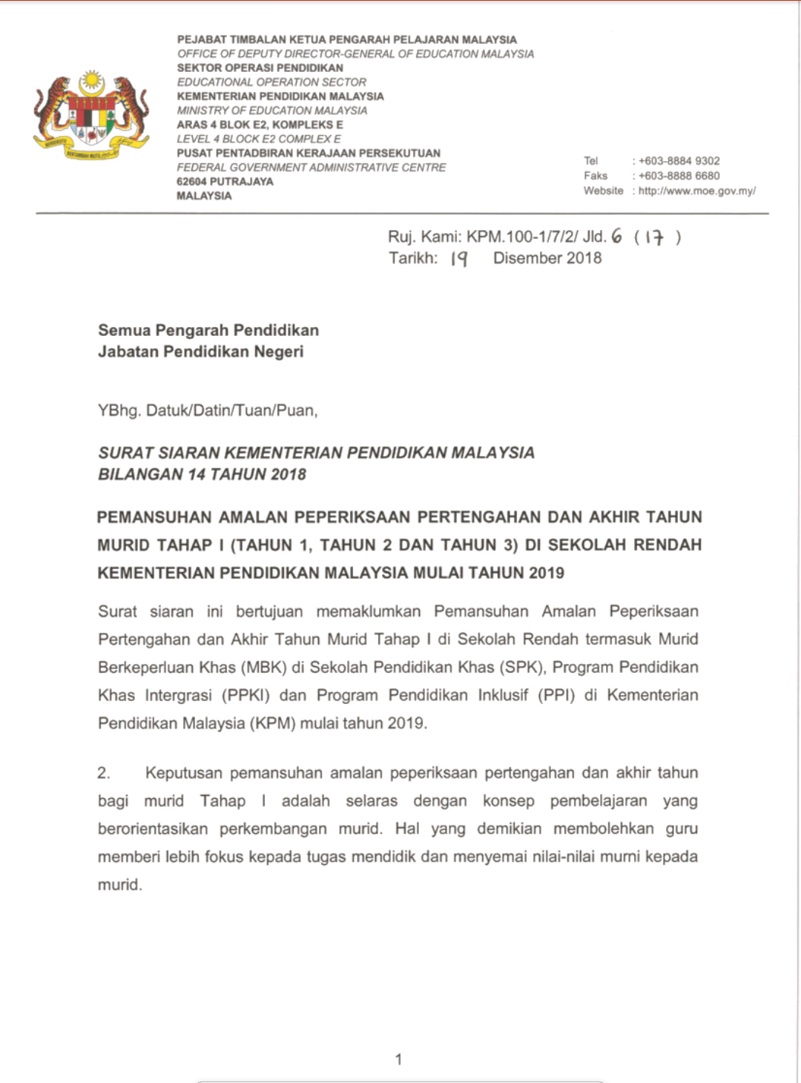

Slide 11
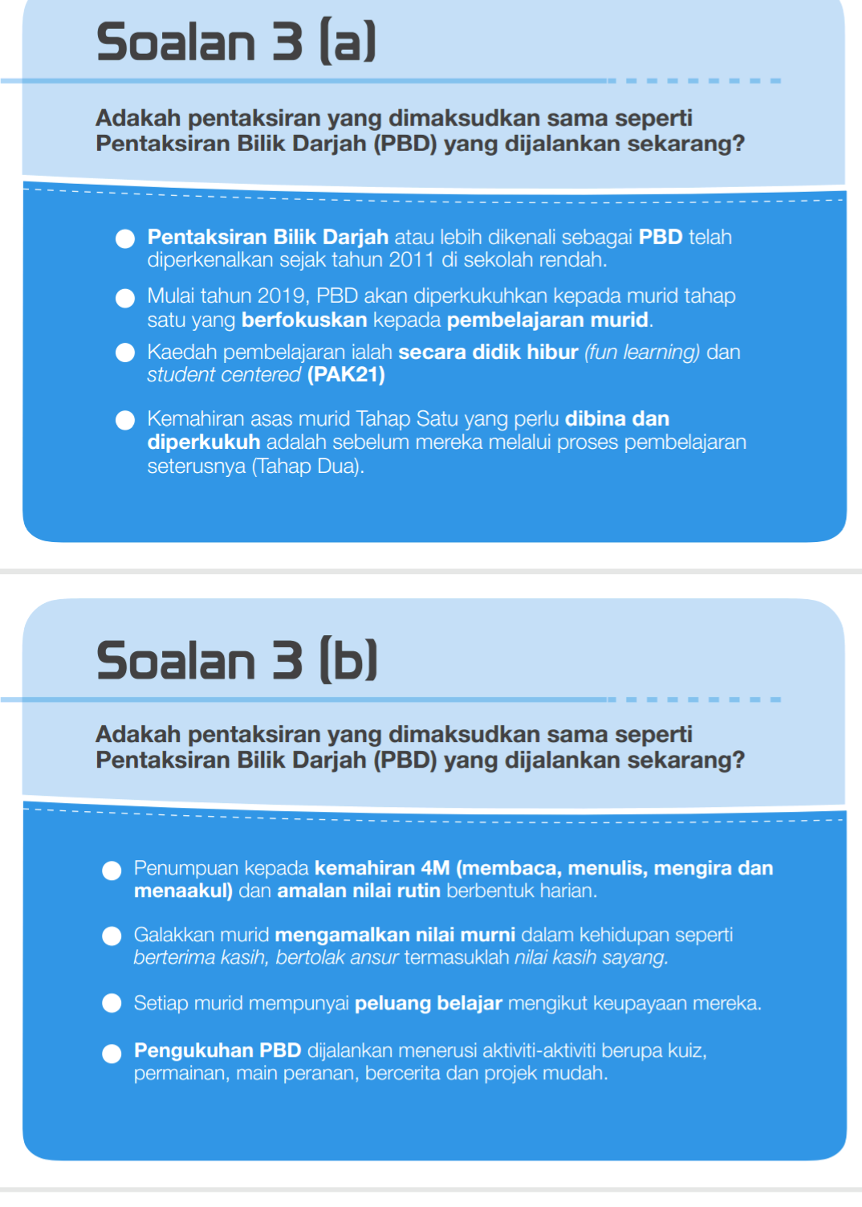

Slide 12
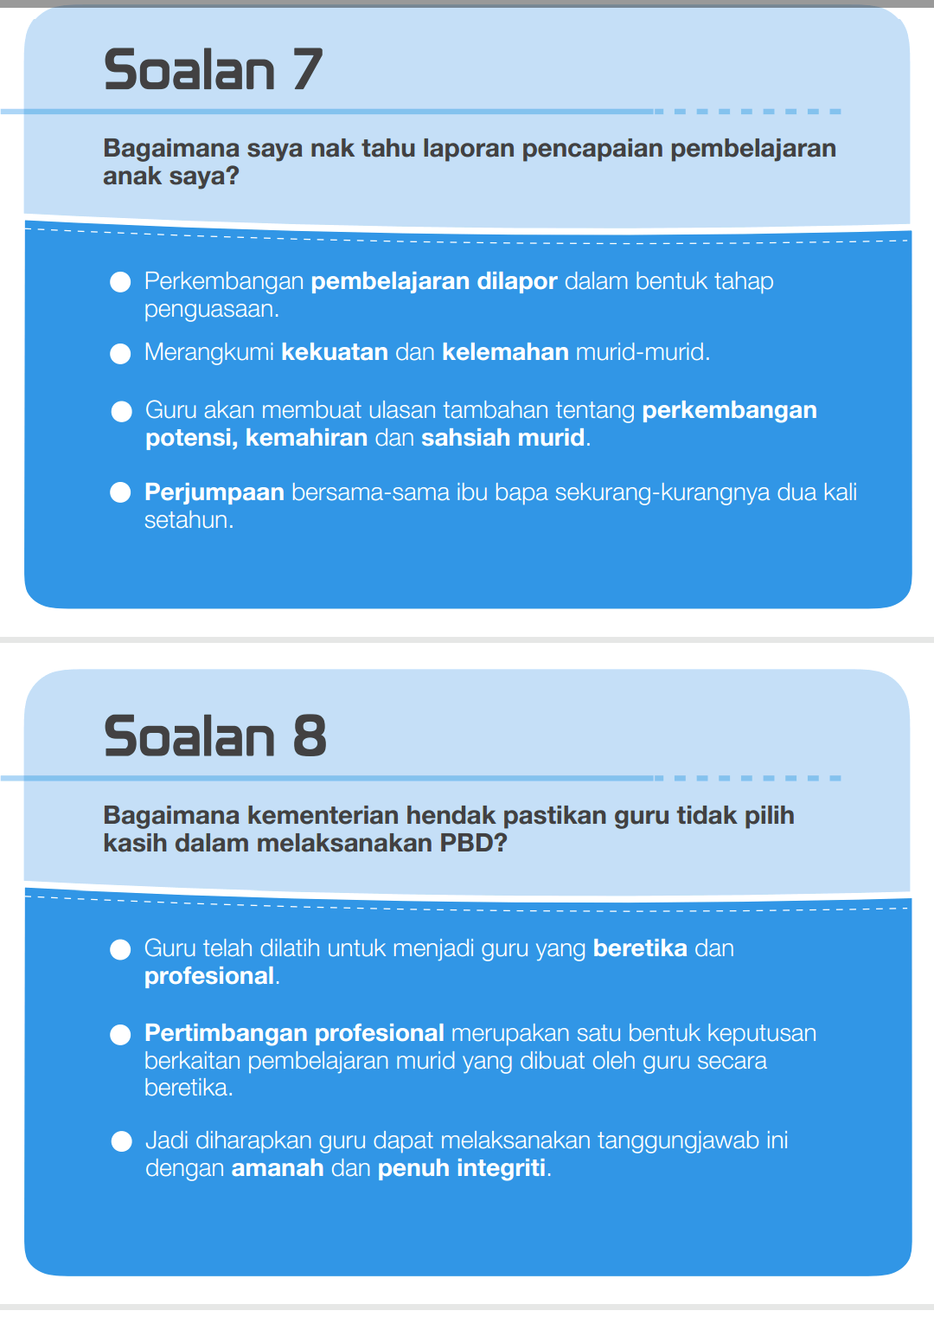

Slide 13
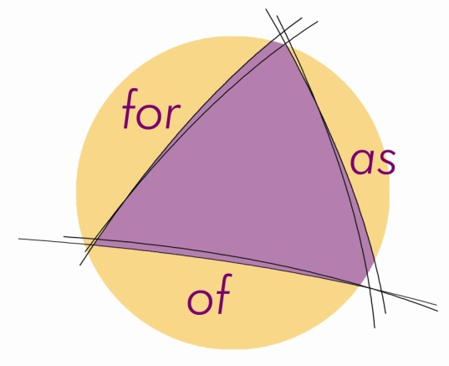
Three main purposes for assessment
Assessment for learning occurs when teachers use inferences about student progress to inform their teaching as well as students learning. (formative)
Assessment as learning occurs when students reflect on and monitor their progress to inform their future learning goals. (formative)
Assessment of learning occurs when teachers use evidence of student learning to make judgements on student achievement against goals and standards. (summative)
Notes:
This slide refers to the three main purposes for assessment, Assessment for learning, Assessment as learning and Assessment of learning.
The first two purposes refer to assessment being used formatively, while the third purpose refers to assessment being used summatively.
Assessment for and as learning occur while students are engaged in the process of learning, while assessment of learning occurs at the end of a learning process or task or unit of work or for reporting at the end of a time period such as a semester.
The three main purposes of assessment are complementary of each other and all three together are very powerful in improving student learning.

Slide 14
Formative vs Summative

Slide 15
What is alternative assessment?
Alternative Assessment is performance assessment that
emphasizes that these assessment methods provide an
alternative to traditional paper-and-pencil testing
(Gronlund & Waugh, 2009).
Under alternative assessment, including:
authentic assessment
performance-based assessment
Portfolios
projects

Slide 16
Alternative or Traditional
Alternative assessments: those assessments that overcome the limitations of pencil-and-paper testing.
Traditional assessment: refers to paper-and –pencil testing which include selection type items or construction type items

Slide 17
Definition
Any method of finding out what a student knows or can do that is intended to show growth and inform instruction and is alternative to traditional forms of testing, namely, multiple-choice tests.
Multi-assessment methods, rather than sticking to traditional paper-and-pencil tests.

Slide 18
In education "alternative assessment" is in direct contrast to what is known as traditional testing" "traditional assessment," or "standardized assessment."
Development resulted from criticism of pencil-and-paper testing and the need for assessments that focused on more meaningful student learning.
Focus on application of knowledge and skills as well as higher levels of real-world application.

Slide 19
Characteristics of Alternative Assessment
Require students to perform, create, produce, or do something
Use real-world contexts or simulations
Assess students on what they do in class every day
Focus on processes as well as products
Higher-level thinking and problem-solving skills
Provide information about students’ strengths and weaknesses
Use human judgment in scoring

Slide 20
Why Alternative Assessment?
Uncertain about test scores
No such thing as a perfect test
Multi-method assessment in order to account for multi-culture, multi-intelligences of learners
It can assess learning processes in an on-going manner
Many lecturers become dissatisfied with the mismatch between how they teach and how assessment is done

Slide 21
Authentic Assessment
Authentic Assessment is performance assessments that stresses the importance of focusing on the application of understandings and skills to real problems in “real-world” contextual settings (Gronlund & Waugh, 2009).
Examples: Simulations, Microteaching, Teaching Practice (educational tasks resemble real-life tasks).

Slide 22
Performance Assessment
Performance Assessment is any assessment requiring students to demonstrate their achievement of understandings and skills by actually performing a task or set of tasks (Gronlund & Waugh, 2009).
Examples: oral presentation, play a musical piece, writing a story or poem, report on an experiment, operate a machine, create a painting.

Slide 23
Projects
A Project is long term activity that results in a student product: a model, a functional object, a substantial report, or a collection (Nitko & Brookhart, 2007).
Projects are long-term tasks in which students have the opportunity to carry out in-depth study of a particular topic (Plessis, 2010).
e.g., research project, art and craft portfolio.

Slide 24
Portfolios
A Portfolio is an extended performance assessment that includes multiple samples of student product or performances (Airasian & Russell, 2008).
It is a collection of student work, gathered over time, for a purpose (Gallagher, 1998; Plessis, 2010).
A portfolio is a collection of student work that has been selected and organized to show student learning progress (developmental portfolio) or to show samples of student’s best work (showcase portfolio).

Slide 25
For trying new and alternative modes of assessment:
Use professional judgment and intuition
Don’t let it be a burden
Try the technique/mode out on yourself
Allow ample time for assessment and feedback
5. Provide feed-up, feed-back, feed-forward to students about it
6. Discuss it with your colleagues.

Slide 26
Student presentation

Slide 27
Options for Recording Student Performance
Rubrics
Descriptions of students performance expectations linked to a scale for evaluating the work
Checklists
List of objectives or behaviors to be observed
Rating scale
To record observations and students can use them as self-assessment tools.
Anecdotal Records
Written notes on observation of student performance

Slide 28
Checklists, rating scales and rubrics are tools that state specific criteria and allow teachers and students to gather information and to make judgements about what students know and can do in relation to the outcomes.
Anecdotal notes are used to record specific observations of individual student behaviours, skills and attitudes as they relate to the outcomes in the program of studies. Such notes provide cumulative information on student learning and direction for further instruction.

Slide 29
What is a Rubric?
“A scoring tool that lists the criteria or 'what counts’ for a piece of work." Heidi Goodrich
A scoring scale used to assess student performance along a task-specific set of criteria

Slide 30
Rubrics
A rubric is a coherent set of criteria for students' work that includes descriptions of levels of performance quality on the criteria.
It should be clear from the definition that rubrics have two major aspects: coherent sets of criteria and descriptions of levels of performance for these criteria.

Slide 31
Rubrics
Rubrics provide the criteria for assessing students' work.
They can be used to assess virtually any product or behavior (process), such as essays, research reports, portfolios, works of art, recitals, oral presentations, performances, and group activities.

Slide 32
Judgments can be self-assessments by students; or judgments can be made by others, such as faculty, other students, fieldwork supervisors, and external reviewers.
Rubrics can be used to clarify expectations to students, to provide formative feedback to students, to grade students, and/or to assess courses and programs.

Slide 33
Table 1: Types of Performances That Can Be Assessed with Rubrics
Type of Performance | Examples
Processes Communication skills Use of equipment Oral communication Work habits | Playing a musical instrument Preparing a slide for the microscope Making a speech to the class Reading aloud Conversing in a foreign language Working independently
Products Constructed objects Written essays, themes, reports, term papers Other academic products that demonstrate understanding of concepts | Watercolor painting Laboratory report Term paper on theatrical conventions in Shakespeare's day Written analysis of the finding Model or diagram of a structure (flower, planetary system, etc.) Concept map

Slide 34
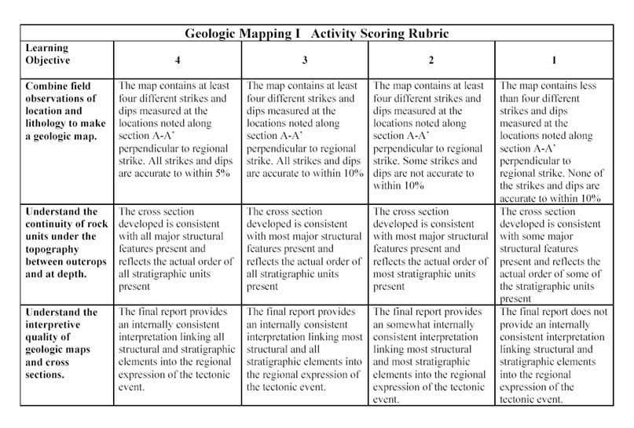

Slide 35
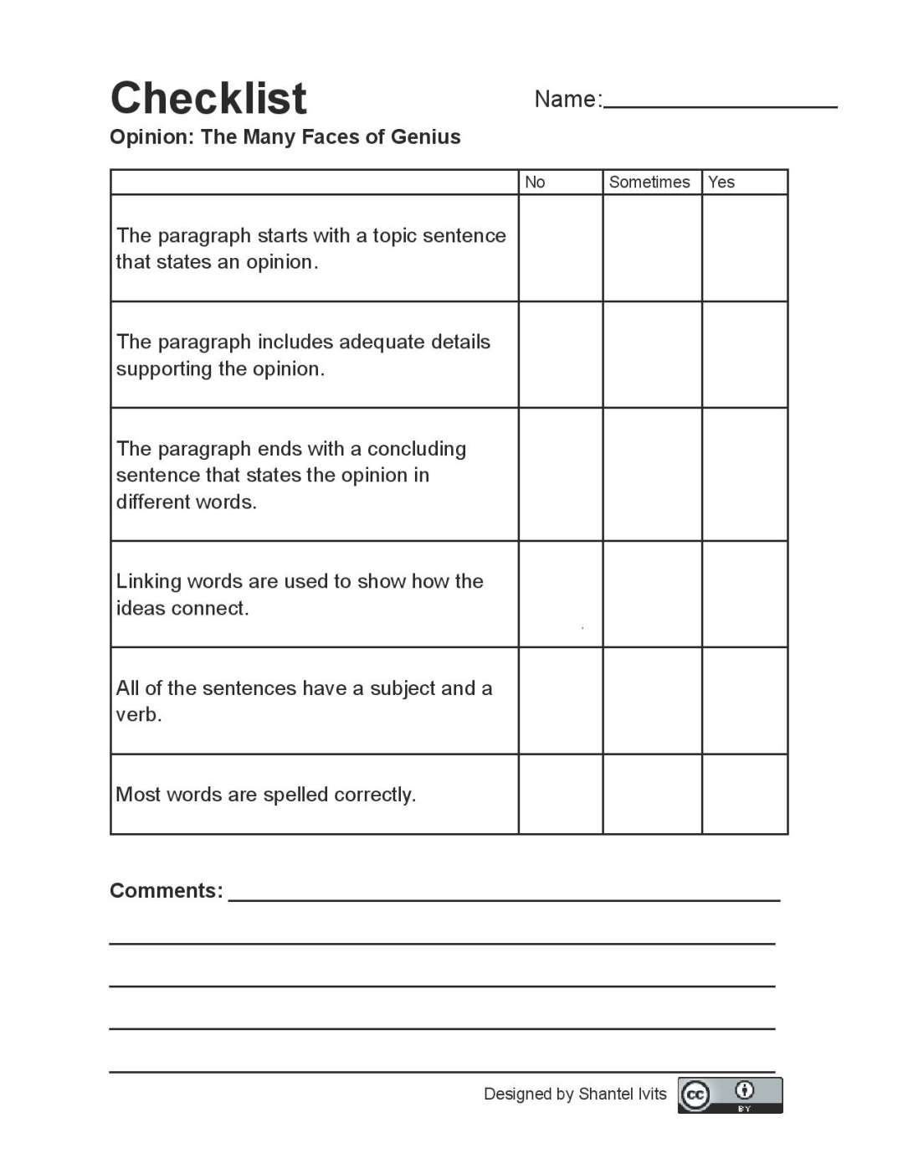

Slide 36
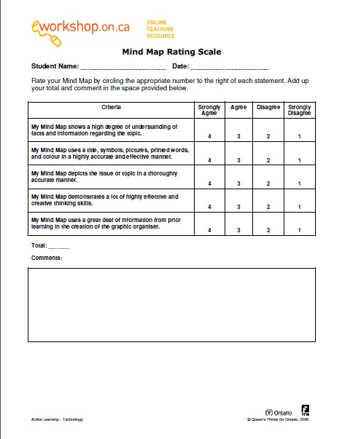

Slide 37
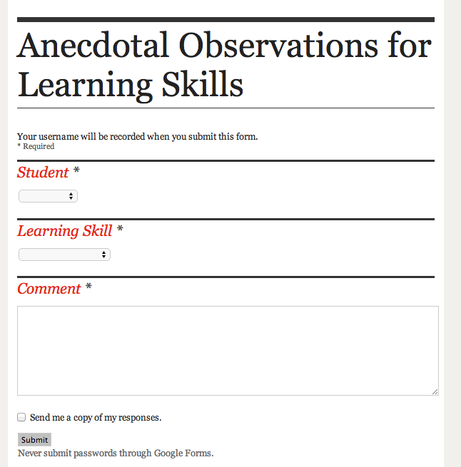

Slide 38
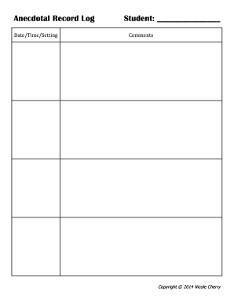

Slide 39
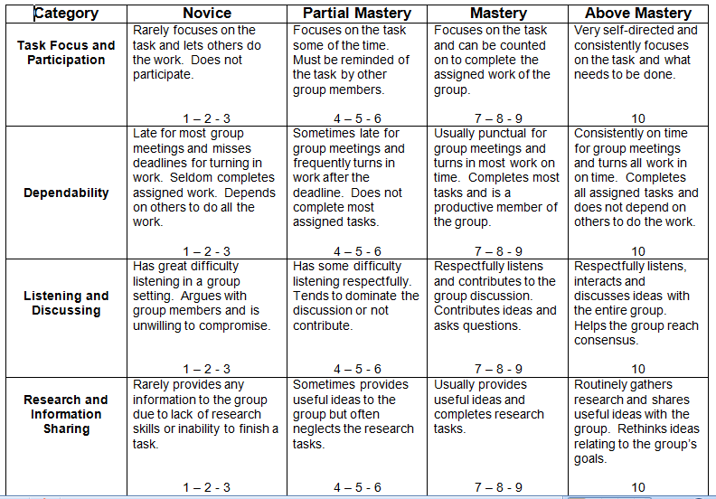
Collaboration Rubric
20%
20%
20%
40%
Notes:
Here is an example of an assessment rubric for the skill of collaboration. The author identified 4 categories that were part of collaboration. The author also chose to have 4 performance categories. It is better to have an even number of fields rather than an odd number. If there is an odd number, people tend to choose the middle. The descriptors are written in full, complete sentences. There is a range given across the bottom of each box that allows teachers to choose scores within the range. This will make the calculation of grades much easier.
You may also weight the categories. For instance, if I considered Research and Information Sharing the most important category, I might give that a weight of 40%, with 20% for each of the other 3.

Slide 40
Group Activity
1. Design a suitable task for authentic assessment for one of the courses that you teach.
2. Discuss the characteristics of authentic assessment with reference to the task you designed.
3. In your opinion, can authentic assessment enhance higher order thinking skills? Elaborate and explain your answer.

Slide 41
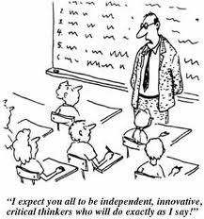
Thank you..

