Slide 1
ASSESSMENT IN INSTRUCTION
Siti Salina Mustakim, PhD
Faculty of Educational Studies
Universiti Putra Malaysia
+6019 334 1307 +603 8946 8198
mssalina@upm.edu.my / salinamustakim@gmail.com
Former Senior Lecturer, Management & Leadership Institution, Malaysia Ministry of Education
Former Assistant Director, Teacher Education Institute, Malaysia Ministry of Education
Former Teacher, Ministry of Education

Slide 2
5 effective communication in the classroom:
Clear instruction
Language used
Body language and facial expression
Voice projection
Questioning technique
TRANSACTIONS = PROCESS OF EDUCATION
Interactions that occur between:
TEACHER – STUDENTS
STUDENTS – STUDENTS
STUDENTS – CURRICULAR MATERIALS
STUDENTS – EDUCATIONAL ENVIRONMENT

Slide 3
Role of teachers in realization of EDUCATIONAL Philosophy of Education
Mentor
Role model
Resource provider
Instructional specialist
Curriculum specialist
Learning facilitator
Advocate High Order Thinking Skills
Classroom supporter
School leader
Agent (catalyst) of change
Life-long learner
Can you explain each role with appropriate example?

Slide 4
WHAT IS ASSESSMENT?
Assessment includes a wide variety of tools & strategies ---------> depending on the nature of the task
that are chosen selectively & purposefully ---------> depending on the amount & type of information required
Assessment TOOLS
Tools are what a teacher uses to record and/or categorize his or her observations/assessment data gathered through the use of various strategies
Tools should provide a clear picture of what the learning should look like (e.g. criteria & indicators)

Slide 5
TYPES OF Assessment TOOLS
Test
Checklists
Rating scale
Sample of writing/work
Direct observation
Interviews
Oral reports
Research projects
Performance tasks
Rubrics
Observation surveys
Exemplars
Running records
Students’ records of their independent learning
Portfolios
Anecdotal records
Conferences

Slide 6
Assessment Types
Formative - for performance enhancement
Formal - quizzes, tests, essays, lab reports, etc.
Traditional - tests, quizzes, homework , lab reports, teacher
Summative - for performance assessment
Informal - active questioning during and at end of class
Alternative - PBL’s, presentations, essays, book reviews, peers

Slide 7
Alternative Assessment
Alternative to what? Paper & pencil exams
Alternatives:
lab work / research projects
portfolios
presentations
research papers
essays
self-assessment / peer assessment
lab practical
classroom “clickers” or responder pads

Slide 8
Assessment Concerns
Validity -- Is the test assessing what’s intended?
Are test items based on stated objectives?
Are test items properly constructed?
Difficulty -- Are questions too easy or too hard? (e.g., 30% to 70% of students should answer a given item correctly)
Discriminability -- Are the performance on individual test items positively correlated with overall student performances? (e.g., only best students do well on most difficult questions)

Slide 9
NEEDS ANALYSIS
ASSESSMENT
DESIGN / TRAINING
EVALUATION

Slide 10
ASSESSMENT STRATEGY
PLAN
PREPARE
CONDUCT
ASSESS
EVALUATE
FEEDBACK
REVIEW

Slide 11
ASSESSMENT IN INSTRUCTION
TESTING
MEASUREMENT
ASSESSMENT
EVALUATION
TESTING | MEASUREMENT | ASSESSMENT | EVALUATION
Doing word – to test Question requiring a response yes/no, true/false, MCQ, extended answer, timed essay, competency | Measuring responses Give mark % Singular measurement | Group response Pass fail based on a range of marks | Comparing against set criteria, teacher judgement
a subset of assessment intended to measure a test-taker’s language proficiency, knowledge, performance or skills. | process of observing and measuring learning. It is an on-going process in educational practice, which involves a multitude of methodological techniques. It can consist test, projects, portfolios. | is the assigning of numbers to certain attributes of objects, events, or people according to a rule-governed system. | involves the interpretation of information. When a tester or marker evaluate, s/he “values” the results in such a way that the worth of the performance is conveyed to the test-taker.

Slide 12
FRAMEWORK OF ASSESSMENT
Reasons / Purposes of Assessment
Types of Test:
Proficiency, Achievement, Diagnostic, Aptitude, Placement
Assessment of Learning Assessment for Learning Assessment as Learning

Slide 13
Assessment OF Learning
Enable students to demonstrate what they know and can do
This type of assessment is also known as summative assessment.
provide the focus to improve student achievement, give everyone the information they need to improve student achievement, and apply the pressure needed to motivate teachers to work harder to teach and learn.
Assessment FOR Learning
Establishes a classroom culture that encourages interaction and the use of assessment tools
Occurs throughout a learning sequence and is planned when teachers design teaching and learning activities
Involves teachers sharing learning intentions and explicit assessment criteria with students
Involves teachers and students setting and monitoring student progress against learning goals
Require teachers to ascertain students’ prior knowledge, perceptions and misconceptions
Is roughly equivalent to formative assessment – assessment is intended to promote further improvement of student learning during the learning process. Students are provided valuable feedback on their own learning
Assessment AS Learning
Promotes students’ self-esteem and self-confidence through an understanding of how they learn to learn
Develop students’ capacity to reflect on the learning and to contribute to their future learning goals
Enhance students’ life-long learning skills. This type of assessment is also known as summative assessment.
Emphasis the process of learning as it is experienced by the student

Slide 14
Assessment OF Learning
TEACHER’S ROLE
Assessment FOR Learning
Assessment AS Learning
a range of alternative mechanisms for assessing the same outcomes
public and defensible reference points for making judgements
transparent approaches to interpretation
descriptions of the assessment process
strategies for recourse in the event of disagreement about the decisions.
Assessment for learning occurs throughout the learning process. It is interactive, with teachers:
aligning instruction
identifying particular learning needs of students or groups
selecting and adapting materials and resources
creating differentiated teaching strategies and learning opportunities for helping individual students move forward in their learning
Providing immediate feedback and direction to students
“The teachers’ role in promoting the development of independent learners through assessment as learning is to:
model and teach the skills of self-assessment
guide students in setting their own goals, and monitoring their progress toward them
provide exemplars and models of good practice and quality work that reflect curriculum outcomes
work with students to develop clear criteria of good practice

Slide 15
Development
Evaluation
Assessment for/as learning
Assessment of learning
What
What
During teaching learning
When
When
At then end of teaching & learning
To improve students’ learning
Why
FORMATIVE
Assessment
Why
To gather students’ development & performance
SUMMATIVE
Assessment
Variety of assessment tools
How
How
Variety of measurement
QA
Based on performance standard
QA
Based on performance standard
Report
Report
Verbal/written report available when required
Quantitative/Cumulative Report is provided every end of semester/year

Slide 16
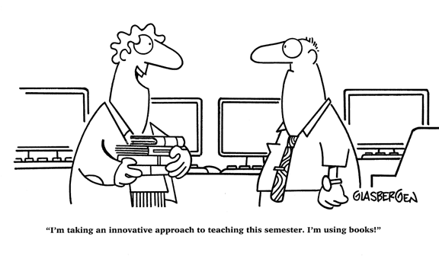
“I’m taking an innovative approach to teaching this semester. I’m using books!”

Slide 17
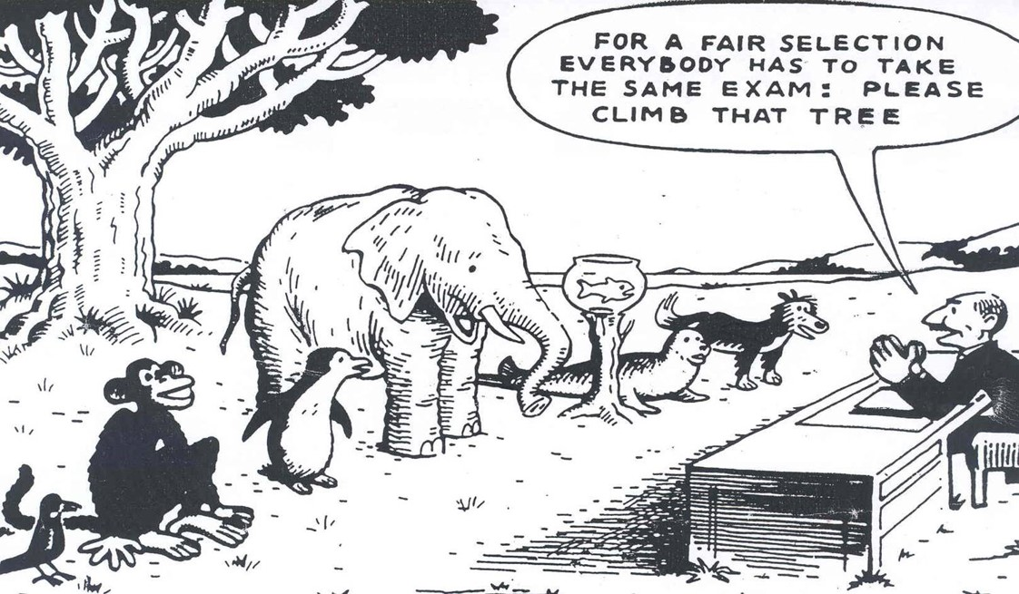
Equality vs Equity
Equity and equality are two strategies we can use in an effort to produce fairness. Equity is giving everyone what they need to be successful. Equality is treating everyone the same. Equality aims to promote fairness, but it can only work if everyone starts from the same place and needs the same help.

Slide 18
AUTHENTIC ASSESSMENT
A form of Assessment in which students are asked to perform real-world tasks that demonstrate meaningful application of essential knowledge and skills.
Usually includes a task for students to perform and a rubric by which their performance on the task will be evaluated.

Slide 19
4 STEPS OF AUTHENTIC ASSESSMENT
Identify the outcomes
Select an authentic task
Identify the criteria
Create a rubric
1
2
3
4

Slide 20
Traditional Assessment
In the TA model, the curriculum drives the assessment. “The” body of knowledge is determined first. That knowledge becomes the curriculum that is delivered. Subsequently, the assessments are developed and administered to determine if acquisition of the curriculum occurred.

Slide 21
Authentic Assessment
In AA, assessment drives the curriculum. That is, teachers first determine the tasks that students will perform to demonstrate their mastery and then a curriculum is developed that will enable students to perform those tasks well, which would include the acquisition of essential knowledge and skills.

Slide 22
SIMILARITIES & DIFFERENCES
Traditional Assessment (TA)
A school’s mission is to develop productive citizens.
To be a productive citizen an individual must possess a certain body of knowledge and skills.
Therefore, schools must teach this body of knowledge and skills.
To determine if it is successful, the school must then test students to see if they acquired the knowledge and skills.
Authentic Assessment (AA)
A school’s mission is to develop productive citizens.
To be a productive citizen, an individual must be capable of performing meaningful tasks in the real world.
Therefore, schools must help students become proficient at performing the tasks they will encounter when they graduate.
To determine if it is successful, the school must then ask students to perform meaningful tasks that replicate real world challenges to see if students are capable of doing so.

Slide 23
Defining Attributes
Traditional……………………….……...Authentic
Selecting a Response……………….Performing a Task
Contrived………….…….…………….Real-Life
Recall/Recognition…………...........Construction/Application
Teacher-Structured…………………Student Structured
Indirect Evidence…………………….Direct Evidence
ALTERNATIVE NAMES
Performance Assessment: Students are often asked to perform real-world or authentic tasks or contexts.
Alternative Assessments: Alternative to traditional assessment using a rubric.
Direct Assessment: Provides more direct evidence of meaningful application of knowledge and skills.
Notes:
-On TA, students are given multiple choices to select the right answer, AA, students are asked to demonstrate understanding by performing more complex tasks usually representative of more meaningful application.
-Contrived v. Real life, It is not very often that outside of school we are asked to select from four alternatives to indicate our proficiency at something. Tests offer these contrived means of assessment to increase the number of times you can be asked to demonstrate proficiency in a short period of time. In life we are asked to demonstrate proficiency by doing something.
-We are often asked to recall or recognize facts and ideas and propositions in life, however, the demonstration of this allows students to analyze, synthesize, and apply what they have learned and create new meaning in the process as well.
-Students are only demonstrating what they know by who developed the test, but although students cannot choose their own topic or format, there are usually multiple acceptable routes towards constructing a product or performance.
-What thinking led the student to pick that answer? Was it a lucky guess?

Slide 24
Why include Authentic Assessments
We want students to use the acquired knowledge and skills in the real world, or authentic situations.
Research on learning has found that we cannot simply be fed knowledge. We need to construct our own meaning of the world, using information we have gathered and were taught and our own experiences with the world.
It encourages the integration of teaching, learning, and assessing.
We have different strengths and weaknesses in how we learn. Similarly, we are different in how we can best demonstrate what we have learned.
Notes:
-So, we have to assess the students to be able to tell if students can apply what they have learned in authentic situations.
-Assessments cannot just ask students to repeat back information. Students need to be given the opportunity to engage in the construction of meaning.
-When presented with a real-world problem to solve, students are learning in the process of developing a solution, teachers are facilitating the process, and the students’ solutions to the problem becomes an assessment of how well the students can meaningfully apply the concepts.

Slide 25
Types of Authentic Tasks
Constructed Response
Product Like:
short-answer essay questions, “show your work”, journal response, concept maps, figural representations.
Performance Like:
Typing test, complete a step of science lab, construct a short musical, dance, or dramatic response, exhibit an athletic skill.
Product
Essays
Stories or Poems
Research Reports
Art Exhibit or Portfolio
Lab Reports
Newspaper
Poster
Performance
Conducting an Experiment
Musical, dance, or dramatic performances
Debates
Athletic competition
Oral presentation
Notes:
-On demand…constructing

Slide 26
Rubrics
Definition: A scoring scale used to assess student performance along a task-specific set of criteria
Comprised of two components:
Criteria
Levels of Performance
Criteria
Each rubric has at least two criteria
The criteria, characteristics of good performance on a task, are usually listed on the left hand column
Can assign a weight to each criterion
Notes:
AA’s are typically criterion-referenced measures (matching performance against criteria to determine performance on tasks)

Slide 27
Types of Rubrics
Analytic
Articulates levels of performance for each criterion so the teacher can assess student performance on each criterion.
Holistic
Assigns a level of performance by assessing performance across multiple criteria as a whole.

Slide 28
Portfolios
Definition: A collection of a student’s work specifically selected to tell a particular story about the student.
Could include the following, but is not limited to :
Samples of work
Reflections
Belief statements
Goals
Evaluations
Notes:
What is the purpose of the Portfolio?
For what Audience will the portfolio be created?
What samples of student work will be included?
What processes will be engaged in during the development of the portfolio?
How will time and materials be managed in the development of the portfolio?
How and when will the portfolio be shared with pertinent audiences?
If the portfolio is to be used for evaluation, when and how should it be evaluated?

Slide 29
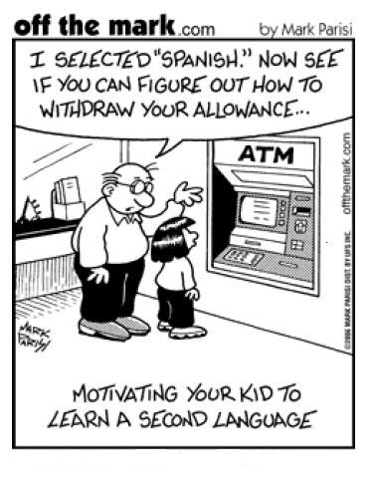

Slide 30
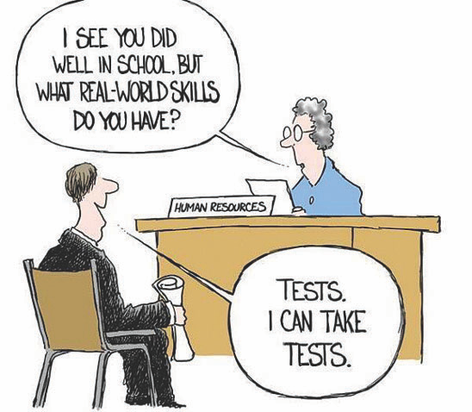

Slide 31
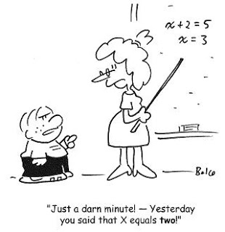

Slide 36
Last night I opened the windows and let mosquitoes all inside then I closed the windows and slept outside.
Its called confusing the enemy.

